Slide 1
Operations on a Linked List

Slide 2
Operations on a Linked List
1. Traversal: Visiting each node in the LL.
2. Insertion: Inserting a new node in the LL.
3. Deletion: Deleting a node in the LL.

Slide 3
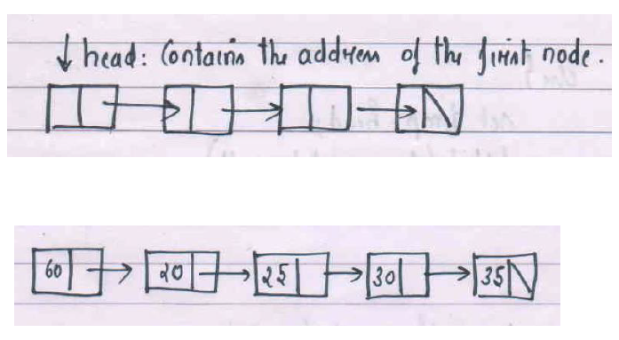
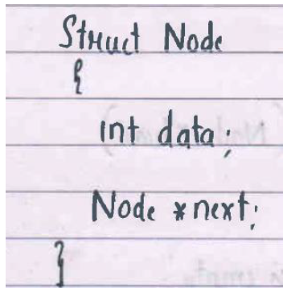
Traversing the Linked List
Process of Visiting each node in the list.

Slide 4
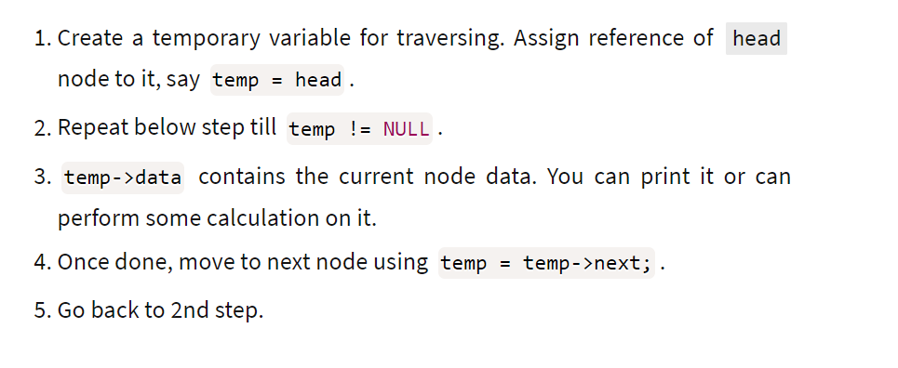
Assumption list is not empty
Time complexity= O(n), where n number of nodes in LL

Slide 5
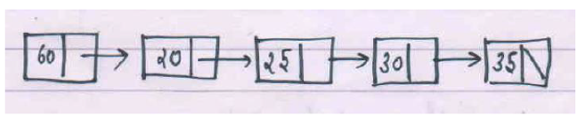
Traversal Logic :
Algorithm Traversal(Node head){
if( head==null) print list is empty.
else{
Node temp=head;
while(temp!=null){
print(temp.data);
temp=temp.next;
}
}
}
Time Complexity = O(n)
}

Slide 6
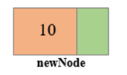
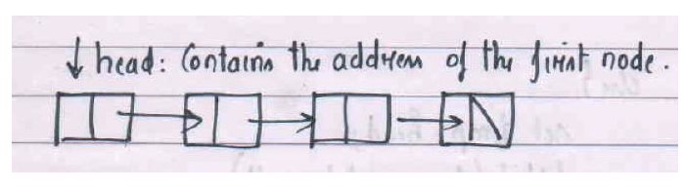
2. Insertion In Linked List.
Insert_ AT_ head(value)
Insert_ AT_Tail(value)
Insert_ AT_Middle(value, position)
Common step in all these insertions is creation of newnode. Assign Data part =value and Address part to null.
Example : newnode.data=10; newnode.next=null.

Slide 7
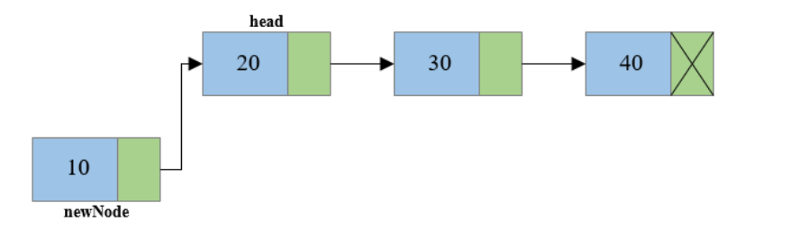
Step 2: Link the newly created node with the head node, i.e. the newNode will now point to head node.
newnode.next= head.

Slide 8
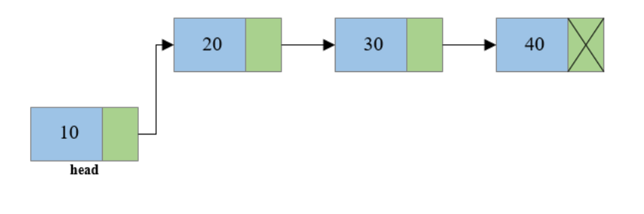
Step 3: Make the new node as the head node, i.e. now head node will point to newNode. ( Statement is head=newnode)

Slide 9
Insert_ AT_ head(value): Logic
Step 1: Create a new node, say newNode points to the newly created node.
newnode.data=10; newnode.next=null
Step 2: Link the newly created node with the head node, i.e. the newNode will now point to head node.
newnode.next= head.
Step 3: Make the new node as the head node, i.e. now head node will point to newNode.
// Write the node definition before writing the steps. No need to draw the diagrams
Time Complexity of Insert_ At_head= O(1)

Slide 10
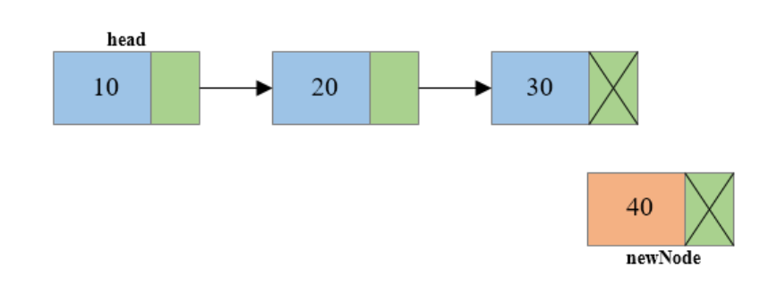
Insert_ AT_Tail(value): Insert a new node at the end
Logic:

Slide 11
Step 1: Create a new node, say newNode points to the newly created node.
newnode.data=40; newnode.next=null.

Slide 12
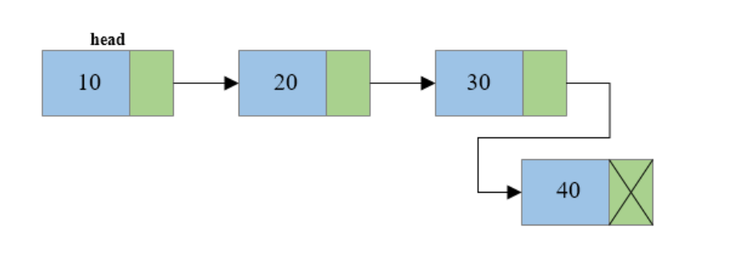
Step 2: Traverse to the last node of the linked list and connect the last node of the list with the new node. Call Traversal().
i.e. last node will now point to new node. (temp->next = newNode).
Time Complexity of Insert_ At_Tail= O(n)

Slide 13
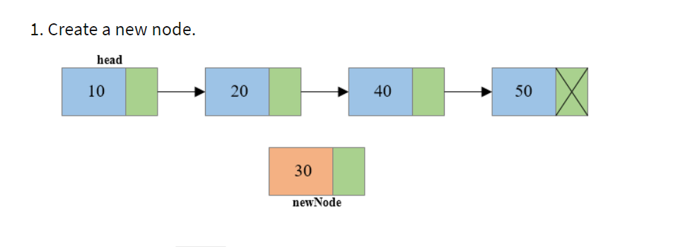
Insert_At_Mid(value,n) // Position is n
Example Insert_At_Mid(30,3)

Slide 14
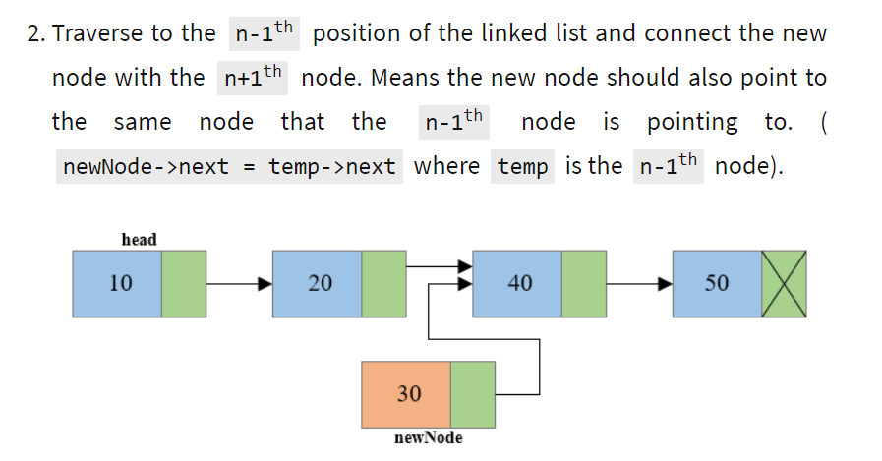
Use traversal to reach n-1th node . After this temp will be n-1th node

Slide 15
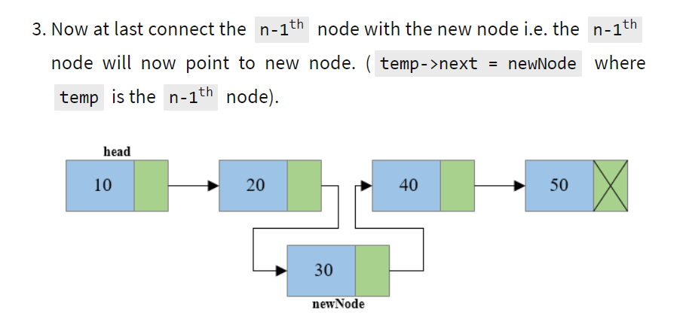
Insert_At_Mid() // Position is n

Slide 16
Insertion Summary:
Insert_ AT_ head() - Time complexity O(1)
Insert_ AT_Tail() - Time complexity O(n)
Insert_ AT_Middle(k)- Time complexity O(K) ; K is the position

Slide 17
To Do List
Learn this LL. One quiz will be there on Saturday. It will be counted for CE.
Write the notes.
To be covered( 30 mins)
Deletion in LL
Stack and Queue using LL

